Slide 1
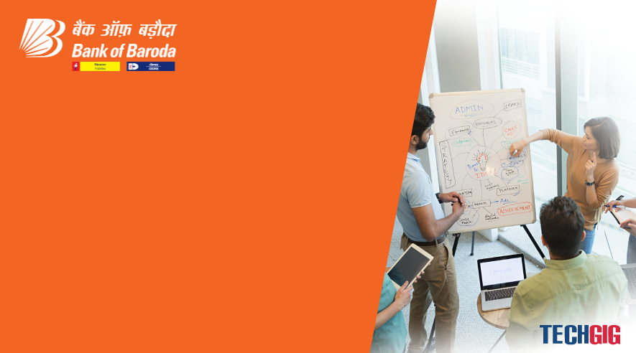

Bank of Baroda Hackathon - 2022
Technology Partner
Your Team Name : Dynamic Energy
Your team bio : 1.M.Swetha - 3rd year, ECE Dept
2.A.Veroni divya - 3rd year, ECE Dept
Date : 19.09.2022

Slide 2
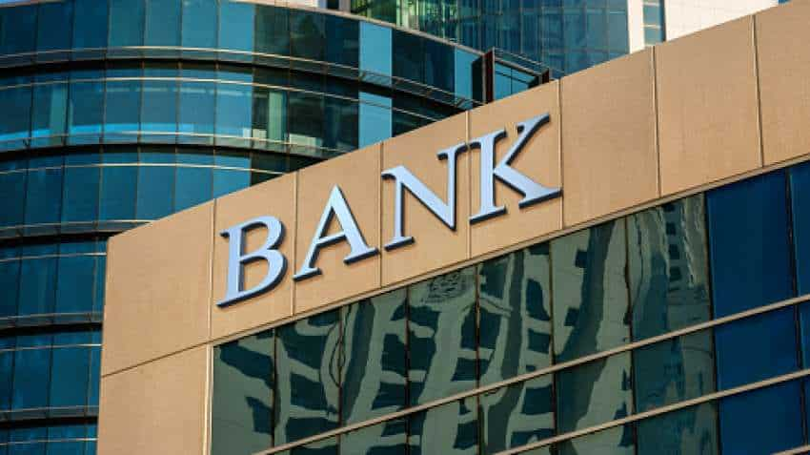
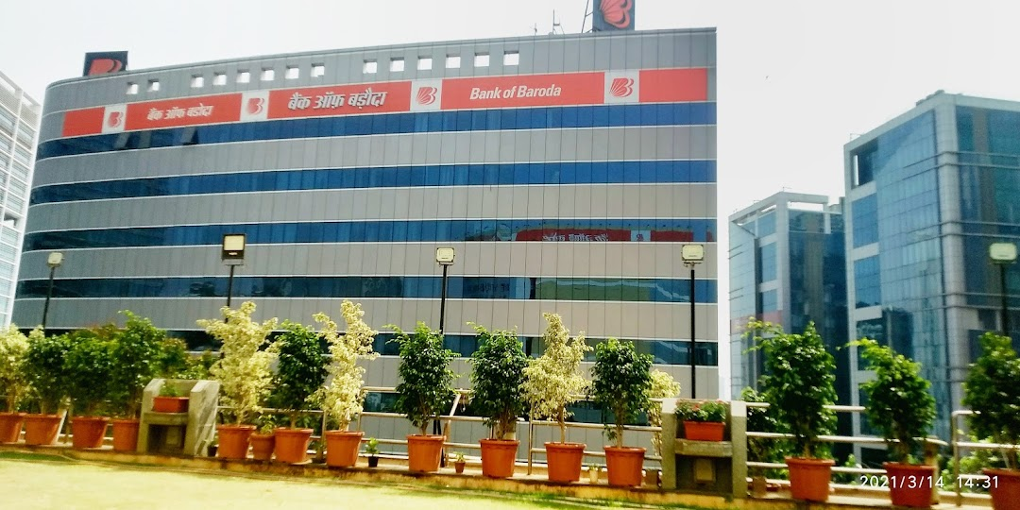
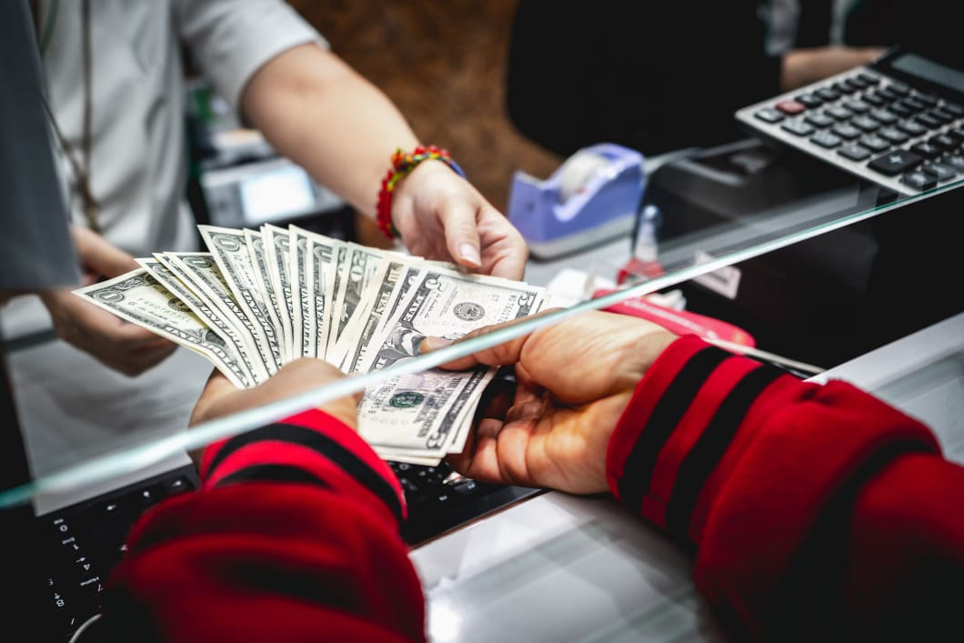
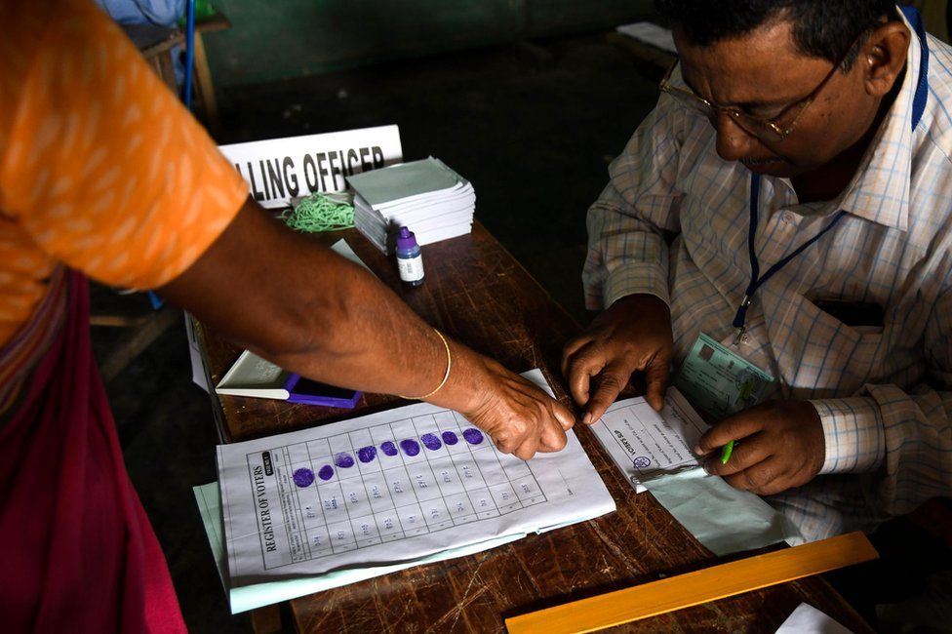
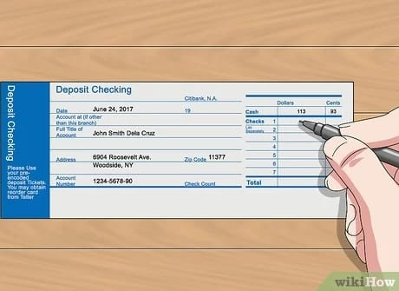
Problem Statement?
PSU banks is set to open about 300 branches in unbanked areas by December 2022.
There are many branches of Bank Of Baroda all over India.Their branches are in rural areas also.
We all know about the importance of banks. Though digital transactions are possible today, still we need banks for depositing money, enquiries etc..
Not everyone is educated. Illiterate people feel uncomfortable since language is a barrier while filling forms and communicating with the officers.
Few forms might get missed while filling them manually.

Slide 3
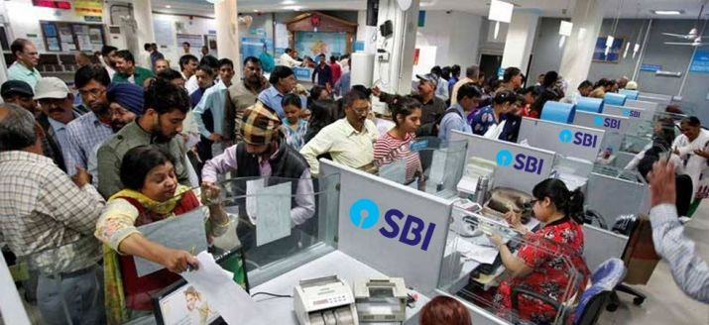
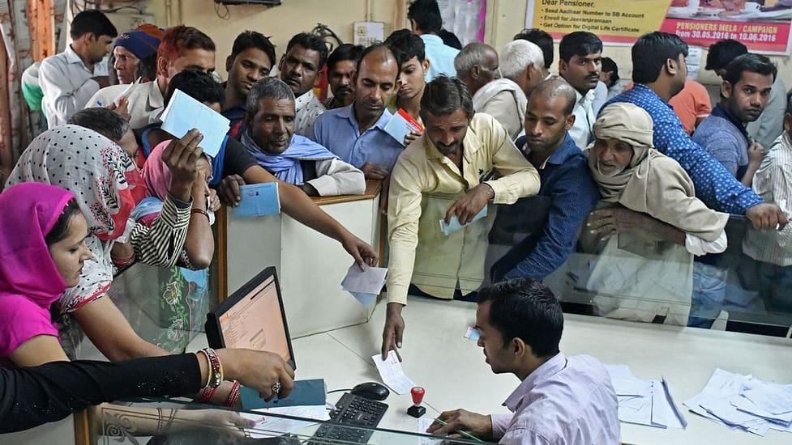
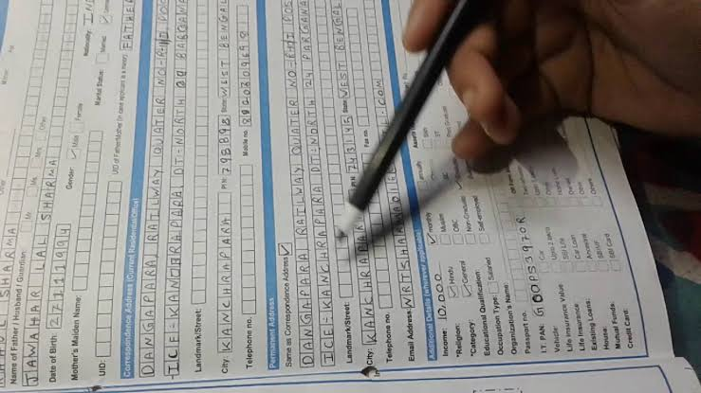
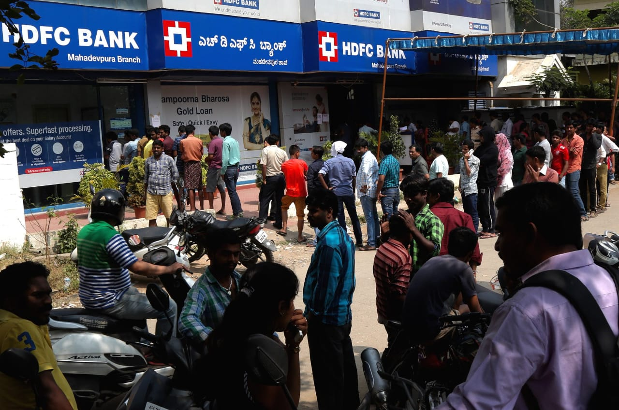
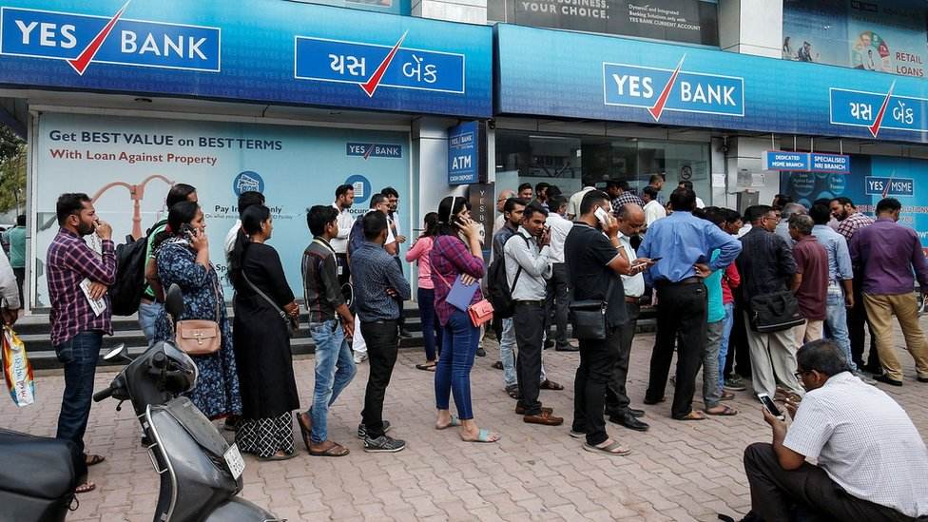
User Segment & Pain Points:
Bank Customers would be Early Adopters of our product.
Increased Work pressure of Bank OffIcers
Language will be the Barrier while filling forms in Bank for Uneducated people.
The Officers need to verify the forms filled by customers in long queues.
Waste of Time for Customers

Slide 4
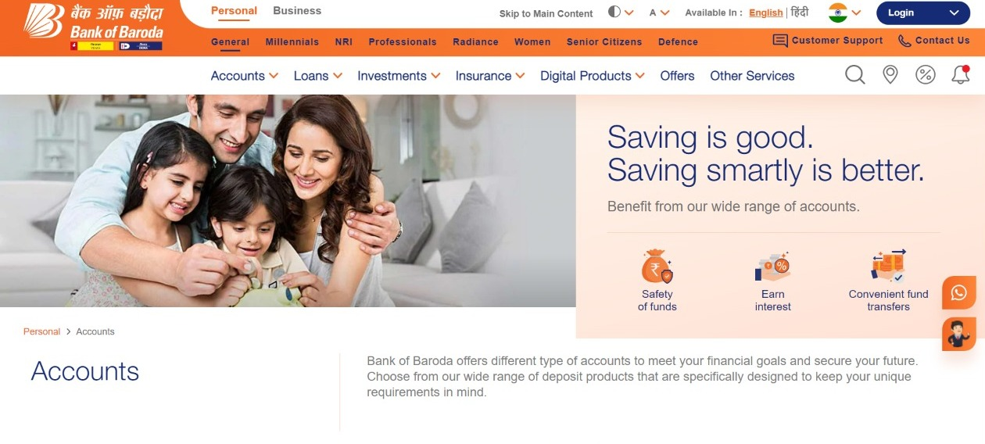
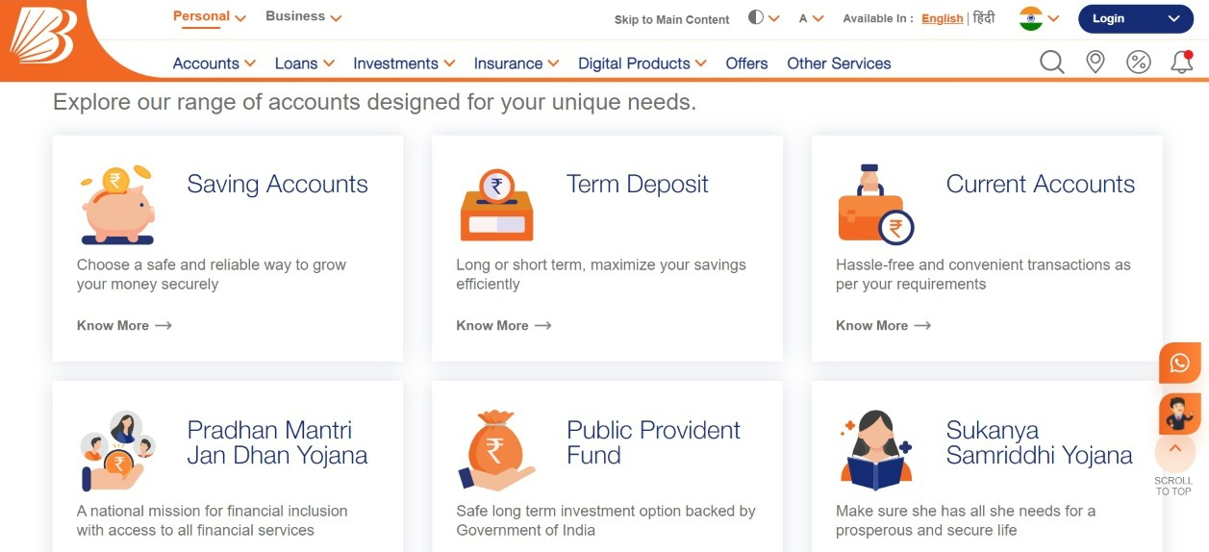
Pre-Requisite:
Digitalized Account Opening
Digitalized Banking Schemes
Opening an Account and filling forms manually in banks.

Slide 5
Azure tools or resources:
1. Microsoft Bot Framework
2. Visual Studio.web network
3. .NET Framework Runtime 4.6.1
4. Cognitive Services

Slide 6
Any Supporting Functional Documents:
Gwen is the Virtual Avatar who assists the Customers in Opening an account, form filling etc..
Gwen speaks to the Customer and asks about the need of him/her.
After listening to the reply of the Customer, Gwen opens the respective form to be filled in the display screen.
Gwen questions the Customers about the details which are needed to fill the form.
Once hearing the answers from the Customers, Gwen automatically starts typing the details in the respective questions.
This process repeats till the entire form is filled.
Signature, Photograph, Pan card, Aadhar card etc.. will be scanned by Gwen through Camera.
After filling the entire form, Gwen saves the filled form as a Document in the system and sends a copy to the e-mail id given by the Customer.
Virtual Avatar - Gwen

Slide 7
Key Differentiators:
EXISTING ALTERNATIVES | VIRTUAL AVATAR
Non existance of Virtual Avatar. | Gwen is the Virtual Avatar who assists the Customers in Opening an account, form filling etc..
Though Digitalized Banking, Form filling are available, details has to be given as input through Keyboard. | Using Speech SDK, Customer’s voice is given as input to the system.
Officers communicate with the customers and the software or system does not. | Gwen speaks to the Customers and replies to their queries.
Photograph is to be pasted in the form and KYC Identification Documents has to affixed along with the form. | Gwen scans the Photograph, Signature and KYC Identification Documents through Camera.
The manually filled form can never be seen by the Customer again. | After the form is filled, it is automatically saved and sent to Customer’s E-mail id.

Slide 8
Adoption Plan:
DURATION | WORK
15 days | Creation of Virtual Avatar
15 days | Echo Bot using Microsoft Bot Framework
15 days | Merging Virtual Avatar and Echo Bot(Voice assistant) and Testing
15 days | Scanning of KYC Identifications

Slide 9
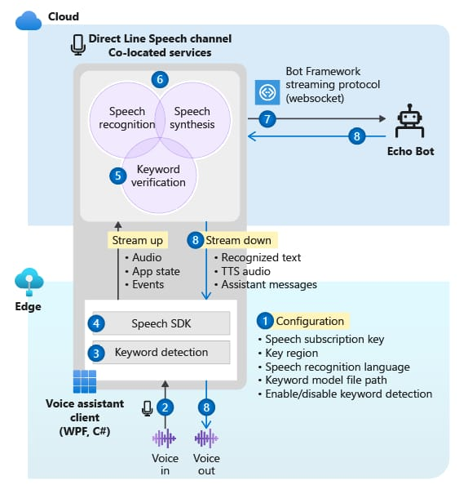
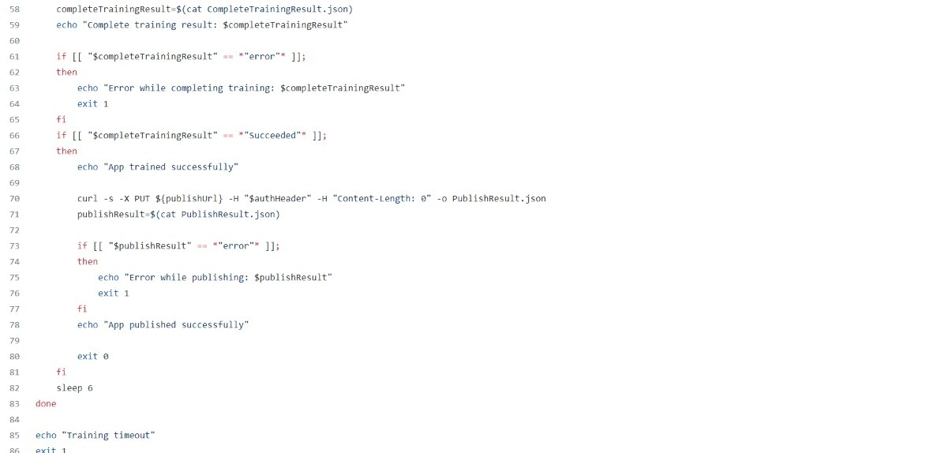
GitHub Repository Link & supporting diagrams, screenshots, if any:

Slide 10
Thank You
TEAM MEMBERS:
1. M.Swetha
2.A.Veroni divya
TEAM MENTORS:
1.Mrs.T.Ruba
2.Mr.A.Nagaraj

